Slide 1
Adaptability. Accountability. Dependability.

Slide 2
About Us
Founded by Bette Dyszel in 1977
In 2000 Josh Dyszel joined Bette and in 2009 became the CEO & President
Headquartered in Long Island, New York with team members across the U.S.
Culture of “Continuous Improvements”
Operations are process-based and audited on an ongoing basis to ensure consistent quality

Slide 3
What We Know
“Close to 50 years of qualitative research experience has taught us one thing: The quality of respondents we recruit and maintain plays a critical role in facilitating successful quality insights. We go out of our way to find them and everything we can do to keep them.”
Look at the article we published…
Notes:
BOLDED – KA/CG don’t like, Josh likes it. -- We out of THE (?) way not our way? … Discussion about alternative synonyms to make it sound better

Slide 4
Methodologies Challenge Us
Traditional, Digital or Multi-Phase Methodologies
We specialize in projects including both traditional & digital methods/phases within a single set of respondents
Partner with us to develop new, innovative and outside-the-box methodologies

Slide 5
Services Not A One-Size-Fits-All Partner
Nationwide Recruiting
Consumer
Healthcare (Physicians & Patients)
Business to Business (B2B)
US-based recruiting for domestic & international agencies and brands
Domestic Field & Project Management
Incentive Distribution & Management
Qualitative & Digital Platform Consultation
We help you choose the right platform
We help you choose a platform provider that incorporates and integrates tools that will yield data and results in accordance with the project goals

Slide 6
In-Person Research (Location Based)
Focus Groups (include Mini-Groups, Triads, Dyads, etc.)
In-Depth Interviews
Ethnographies (Friendship Groups)
CLTs (Central Location Test)
Shop-A-Longs
Home Usage Test | Product Placement
Usability Testing
Customized to study

Slide 7
Digital Methodologies (PC or Mobile App Based))
Online Focus Groups (OLFG)
Online Bulletin Boards (OLBB)
Video Journals | Self Ethnography
Blogs | Diaries
TDI | Web Assisted | Usability testing
Home Usage Test | Product Placement
Customized to study

Slide 8
Respondents + Participants Not just “Qualified,” but Quality!
Nationwide proprietary database
Our database is:
Organically grown
Our Insight Coordinators personally interview/screen each participant to ensure they meet qualifications and have the digital and/or tech resources required by the study
Used only for the coordination of qualitative research
Comprised of diverse respondents
Supplemented with high quality sampling partners
Low quality third party sources are not a part of our process!

Slide 9
Our Recruiting: Approach & Tools
Team-based brainstorming
We invite input and use the extensive knowledge of our experienced team (Strategic Leaders, Project Leaders, Insights Coordinators) to Review | Identify |Adjust | Repeat
Toolbox:
100 % Phone Screening
Social Media (Facebook, LinkedIn, Twitter)
Networking & Referrals (organically grown, 500K+)
Online Surveys
Professional Platforms including premium lead sources

Slide 10
Field & Project Management One Partner. One Message
U.S. Only
Screener Development
Venue Research, Site Selection, & Booking/Reservations
Multi-City Project Management
Trusted partnerships with Facilities and Recruiters
Online Platform Selection & Management
Remote locations: Research where you want it

Slide 11
Quality Assurance
We Are Focused On RESULTS!
100% phone screening to ensure quality and articulated respondents
Cross-referencing to our database & other platforms to eliminate ‘professional respondents’
Continuous improvement culture; we strive to raise-the- bar on our performance and as an extension of our clients’ research team we strive to be on the cutting-edge of existing and emerging technologies

Slide 12
Our Approach
We are your strategic partner and consider ourselves an extension of your research team
We go out of our way to find and keep quality respondents
Respondents earn-the-right to be included in our database or participate in a study
We are eager to try new and cutting-edge technologies
We don’t limit our approach to past experience and always look for new and innovative methodologies and ways of connecting
We collaborate, brainstorm, and welcome clients’ input

Slide 13
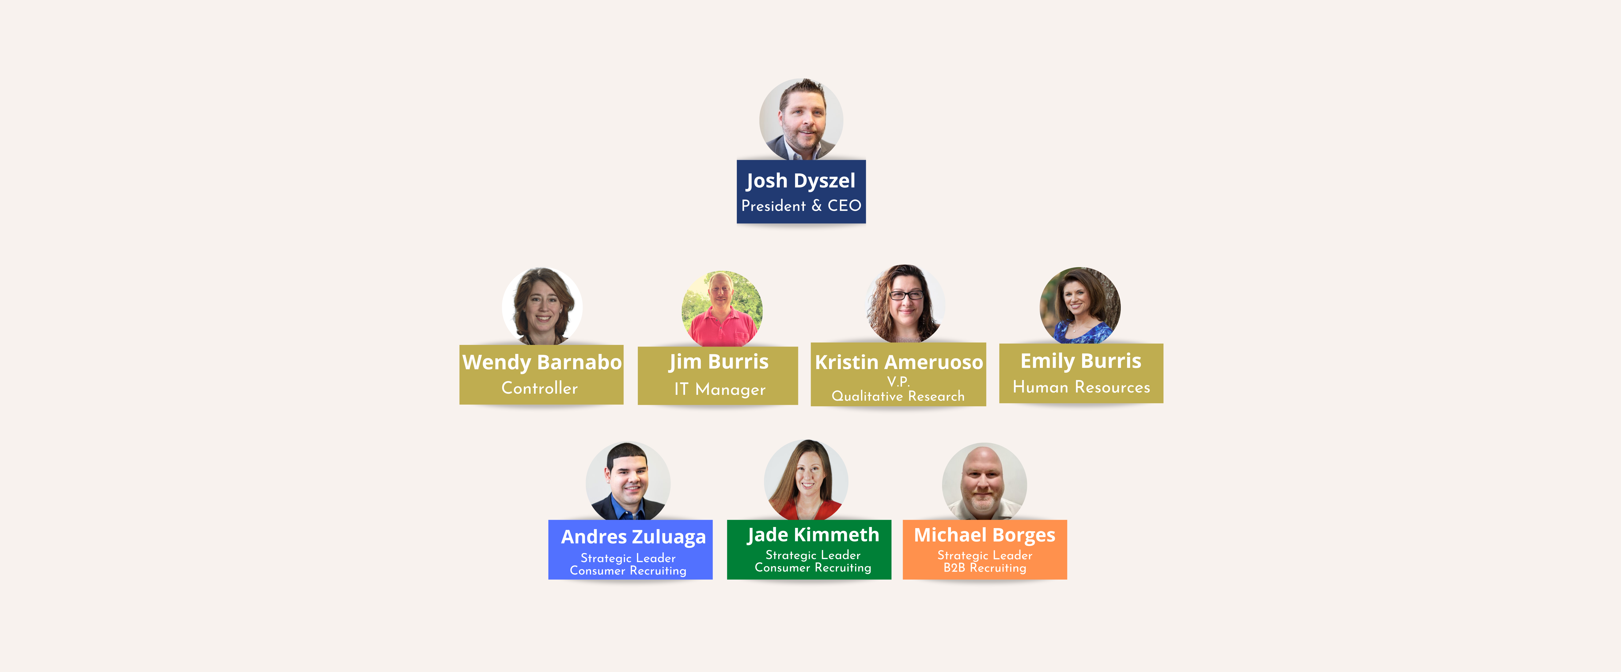
OUR TEAM
Notes:
Josh Likes
Can you remove ? From top of page … looks tacky

Slide 14
OUR PROMISE
Our team members are continuously trained on all the newest qualitative methodologies, and the most efficient recruiting avenues
We are committed to ongoing and timely communication and updates
Our Insights Coordinators are seasoned, competent, tenacious and love what they do
Notes:
Josh Likes
Can you remove ? From top of page … looks tacky

Slide 15
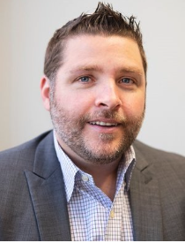
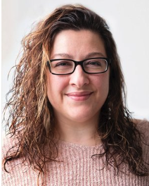
Primary Contacts
Josh Dyszel
CEO /President
Josh@Recruitandfield.com
Kristin Ameruoso
V.P. of Qualitative Research
Kristin@RecruitandField.com (516) 633-3161
Notes:
COULD ADD OUR PHOTOS ??

